Slide 1

7th Grade Math
Unit 11, Lesson 1 Graphing Proportional Relationships Volume 2, pg. 147

Slide 2


Benchmark
MA.7.AR.4.3
Given a mathematical or real-world context, graph proportional relationships from a table, equation, or a written description.
volume 2, pg. 147

Slide 3
Integrated Mathematical Thinking and Reasoning Standards
MA.K12.MTR.1.1 Actively participate in effortful learning both individually and collectively.
MA.K12.MTR.2.1 Demonstrate understanding by representing problems in multiple ways.
MA.K12.MTR.7.1 Apply mathematics to real-world contexts.
volume 2, pg. 147

Slide 4

Learning Targets
I can graph a proportional relationship from a table, an equation, or a written description.
I can describe common features of the graphs of proportional relationships.
volume 2, pg. 147

Slide 5

Warm-Up
volume 2, pg. 147

Slide 6
11.1.1 Warm-Up: Dancing with Math
Karin Ditchfield lived in three different countries growing up – Brazil, England, and Argentina – where three different languages are spoken. Learning new languages can be challenging, but she explains despite these challenges the language of math was always the same.
Karin says, “Math is not just about working with numbers. I see it as a global language that has a positive impact on the world.”
What are some reasons why math could be considered a global language?
volume 2, pg. 147

Slide 7
Karin mentioned that growing up in Brazil meant growing up dancing. She says, “When you’re learning a new dance, practice makes perfect. It’s exactly the same with math.”
Explain whether you agree with this explanation.
volume 2, pg. 147

Slide 8

Exploration
volume 2, pg. 148

Slide 9


11.1.2 Exploration: Graphs of Proportional Relationships
In this course, proportional relationships have been used to make predictions about populations from sample data, create scale drawings, convert between units of measure, and solve problems involving percentages.
A proportional relationship is a collection of pairs of numbers that are in equivalent ratios.
volume 2, pg. 148

Slide 10
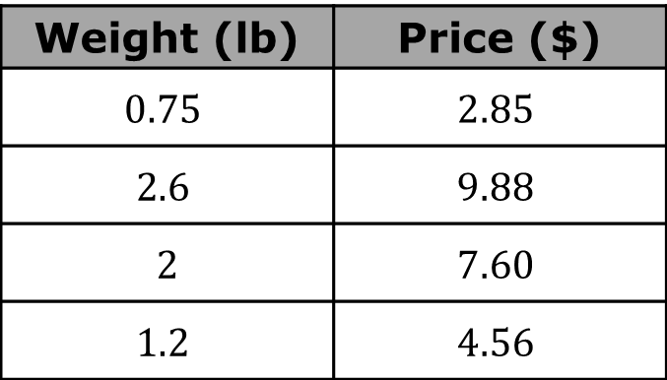
Proportional relationships can be represented by graphs, tables of values, equations, and written descriptions.
Work with your partner to complete the following.
Madelyn and her family went to a U-Pick farm in Lithia, FL to pick blueberries. The table shows the weight, in pounds (lb), and price, in dollars, of the bag of blueberries each family member picked.
What is the unit price per pound of blueberries?
Weight (lb) | Price ($)
$$0.75$$ | $$2.85$$
$$2.6$$ | $$9.88$$
$2$ | $$7.60$$
$$1.2$$ | $$4.56$$
volume 2, pg. 148

Slide 11
Explain how you determined the unit price.
Graph the relationship by plotting a point to represent each family member’s bag of blueberries.
Price ($)
Weight (lb)
volume 2, pg. 148

Slide 12
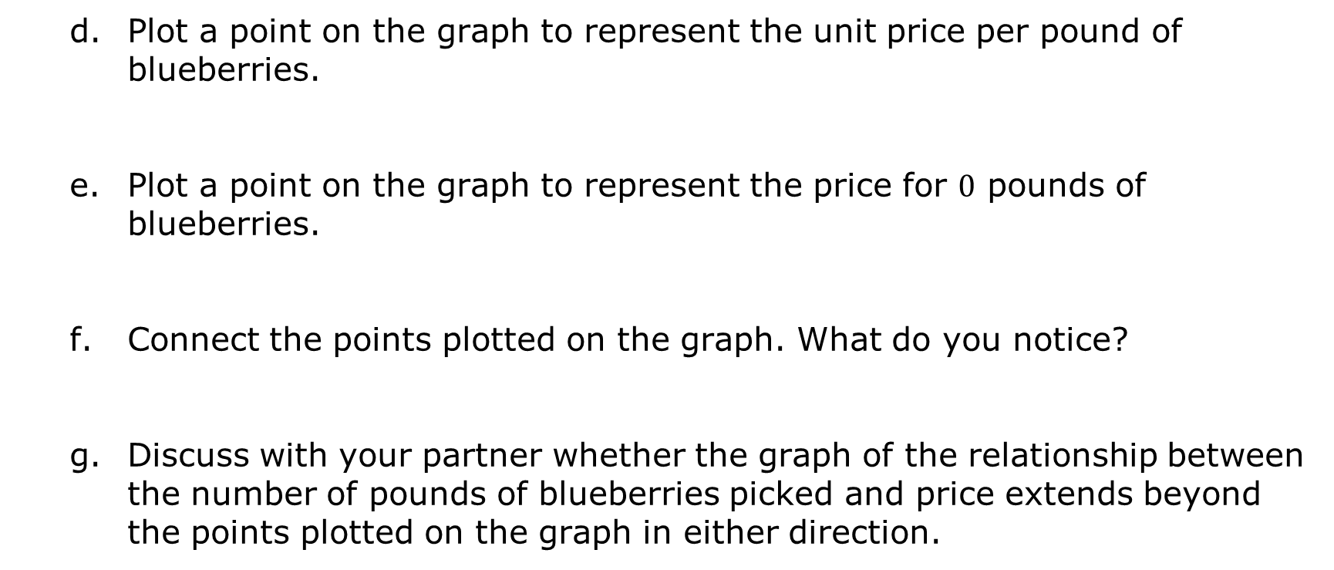
Plot a point on the graph to represent the unit price per pound of blueberries.
Plot a point on the graph to represent the price for $0$ pounds of blueberries.
Connect the points plotted on the graph. What do you notice?
Discuss with your partner whether the graph of the relationship between the number of pounds of blueberries picked and price extends beyond the points plotted on the graph in either direction.
volume 2, pg. 149

Slide 13


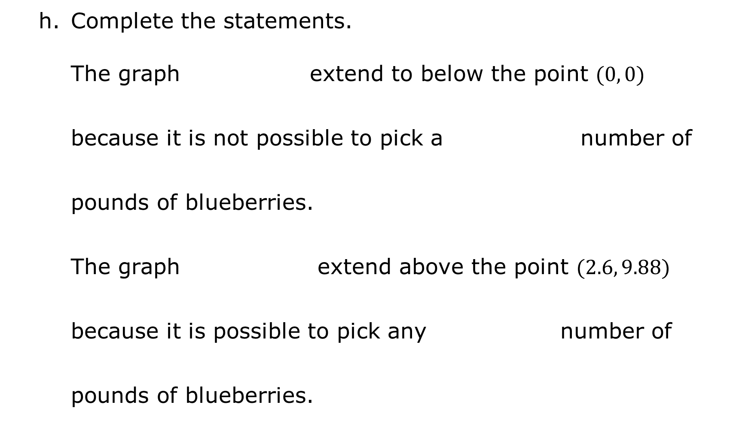
Complete the statements.
The graph extend to below the point $(0, 0)$ because it is not possible to pick a number of pounds of blueberries.
The graph extend above the point $(2.6, 9.88)$ because it is possible to pick any number of pounds of blueberries.
volume 2, pg. 149

Slide 14
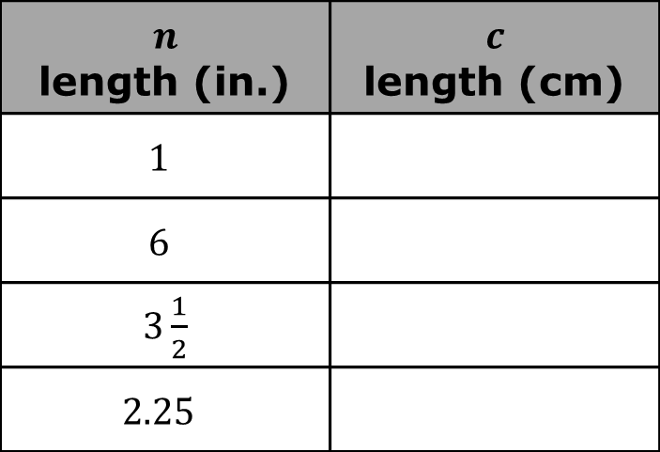
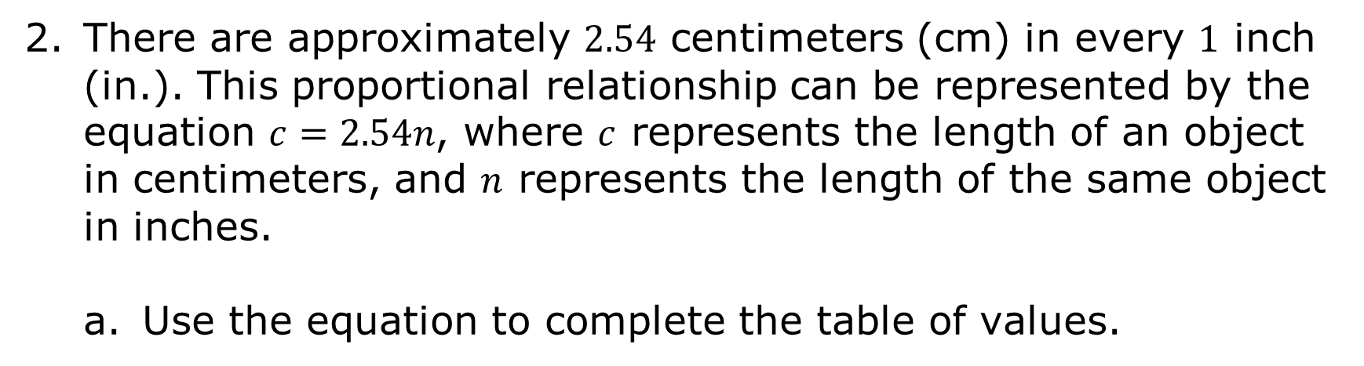
There are approximately $2.54$ centimeters (cm) in every $1$ inch (in.). This proportional relationship can be represented by the equation $c=2.54n$, where $c$ represents the length of an object in centimeters, and $n$ represents the length of the same object in inches.
Use the equation to complete the table of values.
$$n$$ length (in.) | $$c$$ length (cm)
$$1$$
$$6$$
$3\frac{1}{2}$
$$2.25$$
volume 2, pg. 149

Slide 15
Graph the ordered pairs from the table of values.
Length (cm)
Length (in.)
volume 2, pg. 149

Slide 16
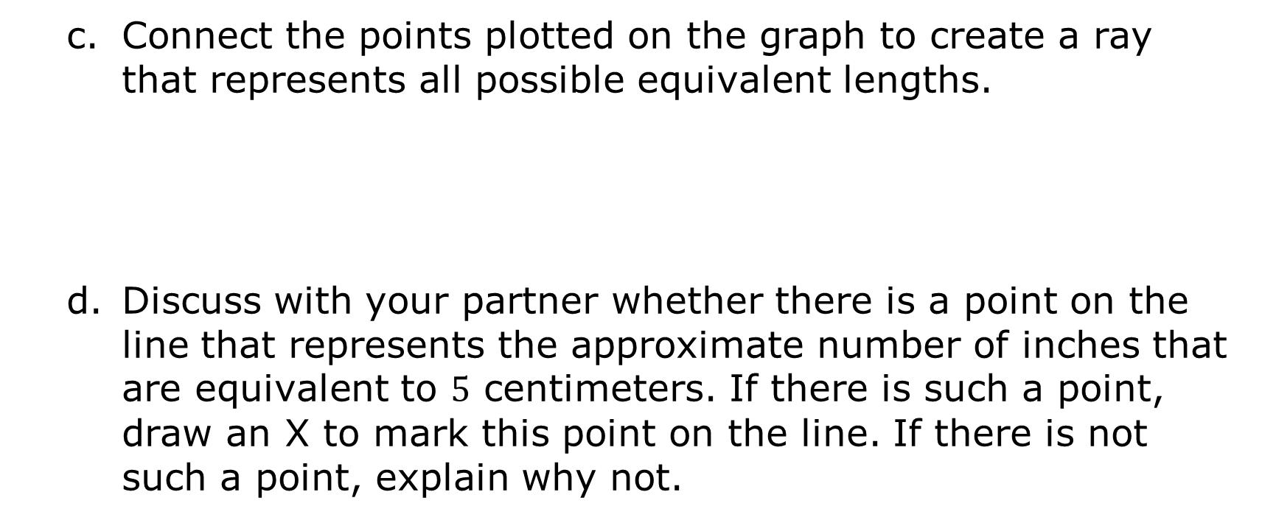
Connect the points plotted on the graph to create a ray that represents all possible equivalent lengths.
Discuss with your partner whether there is a point on the line that represents the approximate number of inches that are equivalent to $5$ centimeters. If there is such a point, draw an X to mark this point on the line. If there is not such a point, explain why not.
volume 2, pg. 150

Slide 17
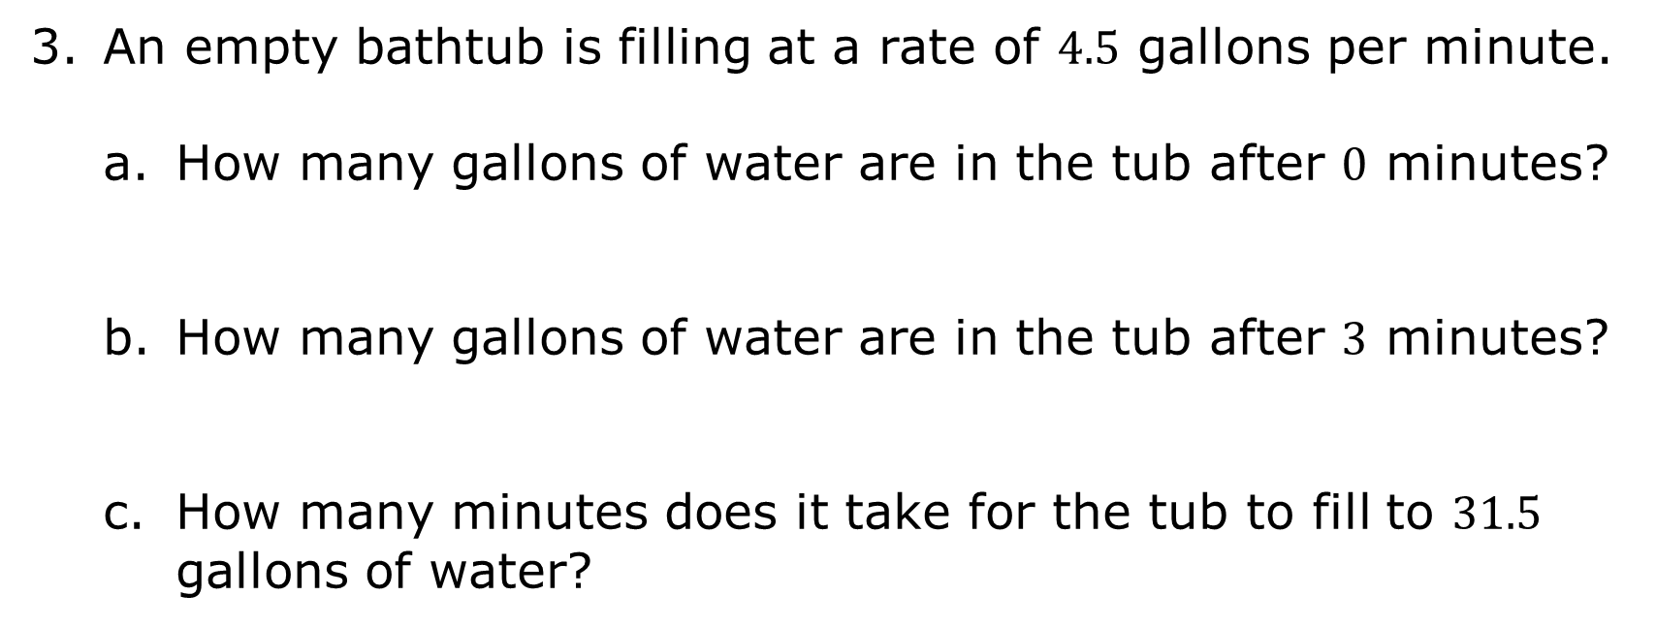
An empty bathtub is filling at a rate of $4.5$ gallons per minute.
How many gallons of water are in the tub after $0$ minutes?
How many gallons of water are in the tub after $3$ minutes?
How many minutes does it take for the tub to fill to $31.5$ gallons of water?
volume 2, pg. 150

Slide 18
Using the values determined in Parts A-C, represent the relationship of the amount of water in the tub, in gallons, with time, in minutes, on the coordinate grid.
Amount of water in the tub (gallons)
Time (minutes)
volume 2, pg. 150

Slide 19


Connect the points plotted on the graph to create a ray.
Complete the statement.
The bathtub is filling up at a constant unit rate of ______ per
Place an X on the graph at the point that represents the unit rate described in Part F.
volume 2, pg. 150

Slide 20

Bring It Together
volume 2, pg. 151

Slide 21



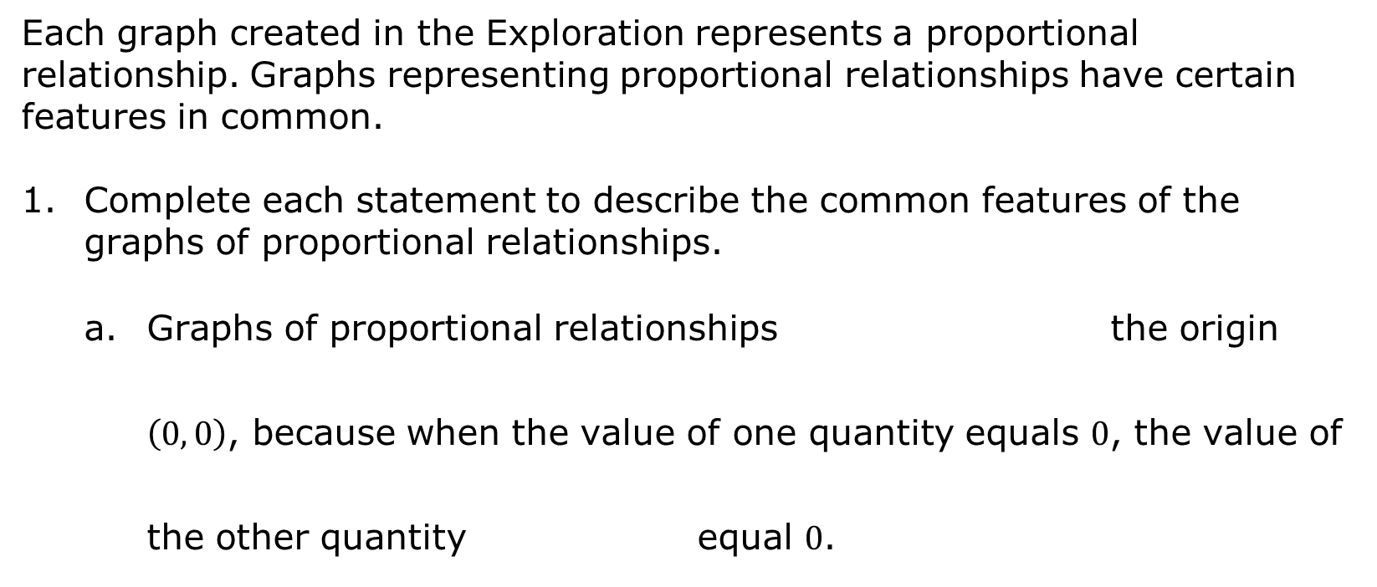
11.1.3 Bring It Together: Graphs of Proportional Relationships
Each graph created in the Exploration represents a proportional relationship. Graphs representing proportional relationships have certain features in common.
Complete each statement to describe the common features of the graphs of proportional relationships.
Graphs of proportional relationships the origin $\left(0, 0\right)$, because when the value of one quantity equals $0$, the value of the other quantity equal $0$.
volume 2, pg. 151

Slide 22

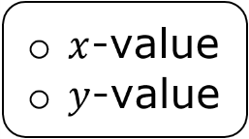
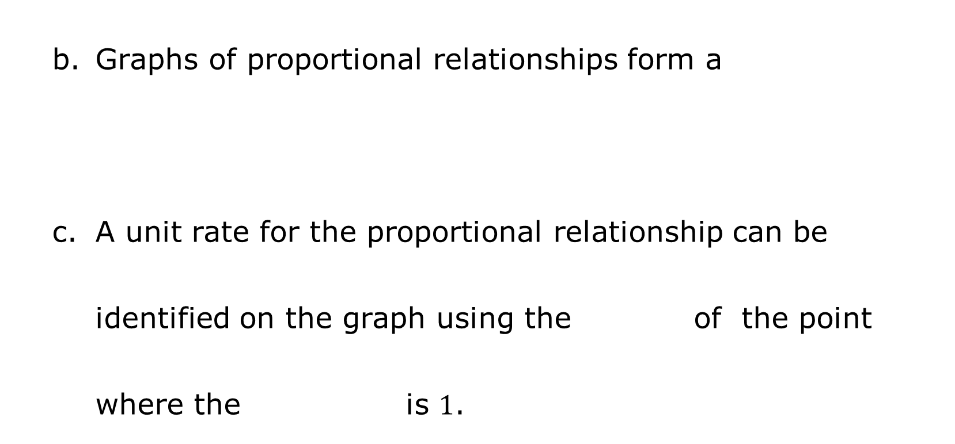
Graphs of proportional relationships form a
A unit rate for the proportional relationship can be identified on the graph using the of the point where the is $1$.
volume 2, pg. 151

Slide 23

Wrap-Up
volume 2, pg. 151

Slide 24
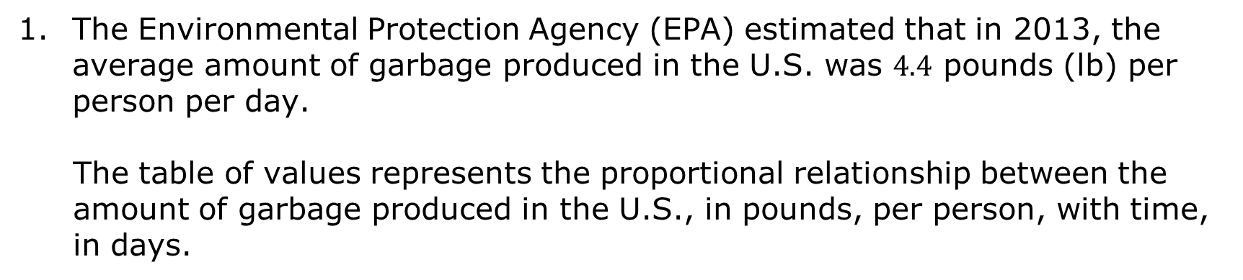
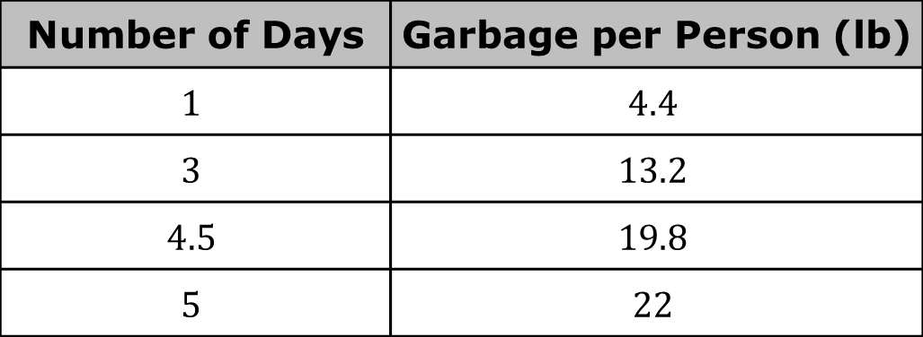
11.1.4 Wrap-Up: Ticket Out the Door
The Environmental Protection Agency (EPA) estimated that in 2013, the average amount of garbage produced in the U.S. was $4.4$ pounds (lb) per person per day.
The table of values represents the proportional relationship between the amount of garbage produced in the U.S., in pounds, per person, with time, in days.
Number of Days | Garbage per Person (lb)
$$1$$ | $$4.4$$
$$3$$ | $$13.2$$
$$4.5$$ | $$19.8$$
$$5$$ | $$22$$
volume 2, pg. 151

Slide 25
Graph this proportional relationship.
Garbage Produced per Person (lb)
Time (days)
volume 2, pg. 151

